Slide 1
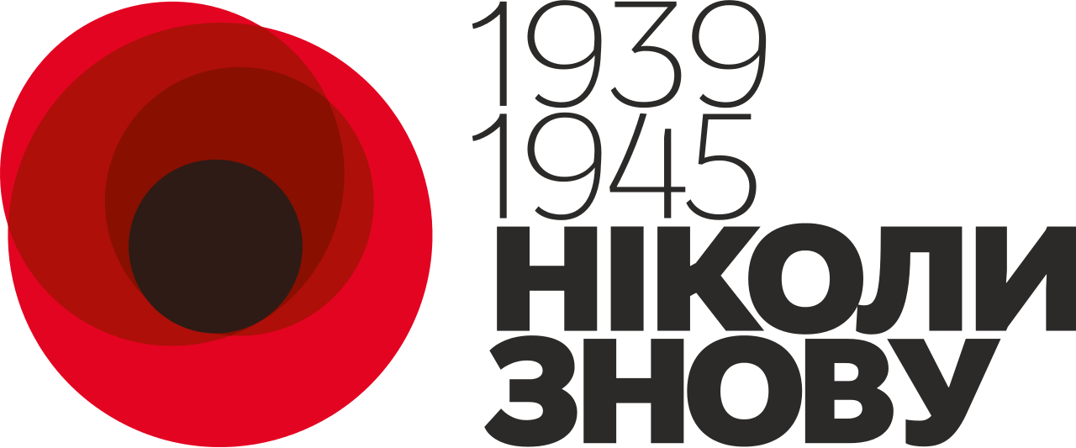
Victory Day
Never
again
Lisnichenko Ruslan 14ПО(ін)

Slide 2
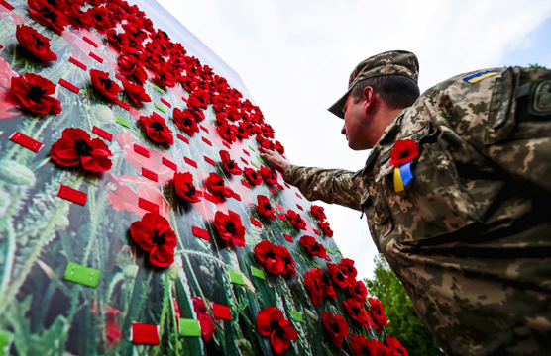
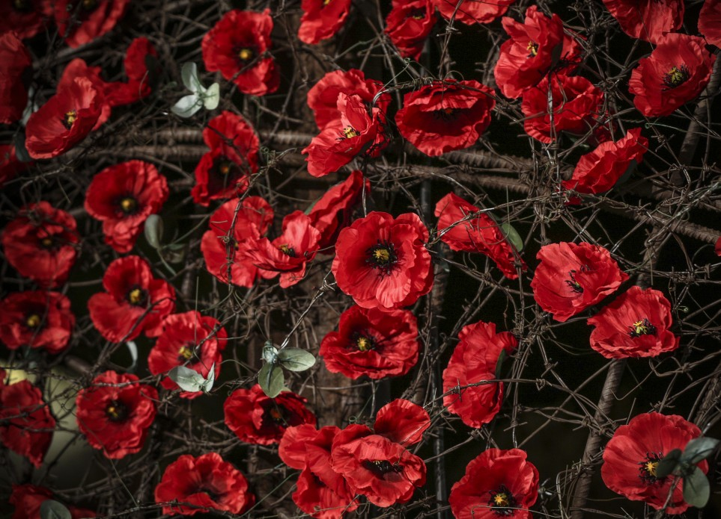
m y 9th
public holiday in Ukraine, which is officially celebrated on May 9, 2016, a day off. The warning was changed to the Soviet holiday Victory Day, which was celebrated in the USSR and then in Ukraine until 2015. The official symbol of the celebration of the Day of Victory over Nazism in the Second World War for several years in a row is the flower of the red poppy - the world's most common symbol of commemoration of memorable days.
"Victory Day over Nazism in World War II" is established as a national holiday in accordance with the law "On improving the Victory over Nazism in World War II 1939-1945", adopted by the Verkhovna Rada of Ukraine on April 9, 2015 as part of a package of laws on decommunization.

Slide 3
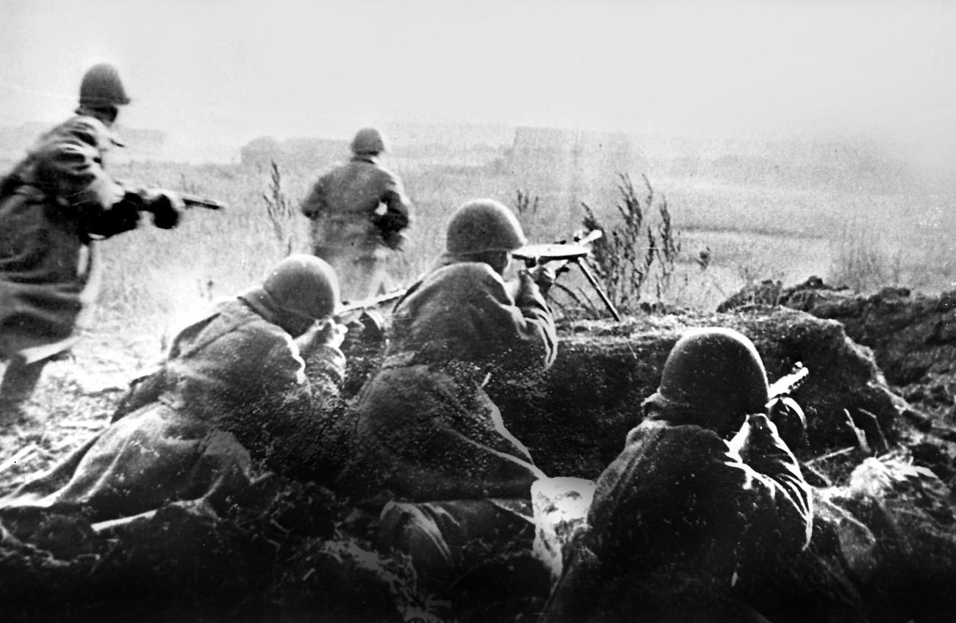
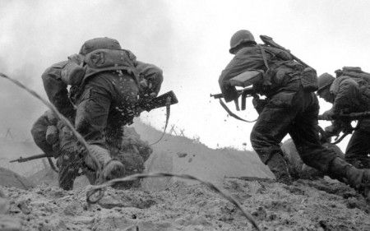
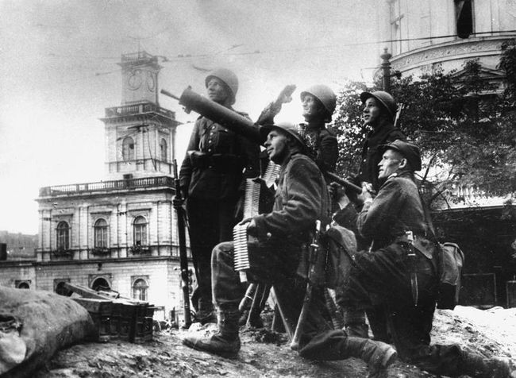
Second World War
World War II began on September 1, 1939 with Nazi Germany's attack on Poland. On that day, German military aircraft bombed Lviv and other cities. On September 17, the Soviet Union became a participant in World War II on the German side. The Soviet army crossed the border of the Republic of Poland and began hostilities against the Polish army. Responding to a secret event with the Then Reich, the USSR occupied the eastern voivodships of the Republic of Poland (the lands of Western Ukraine and Western Belarus).

Slide 4
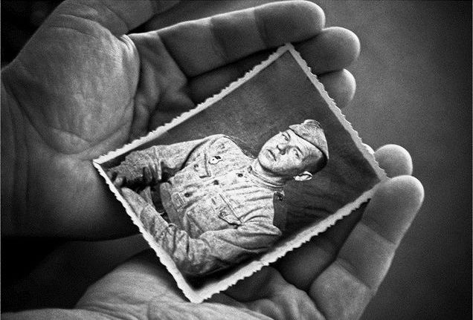
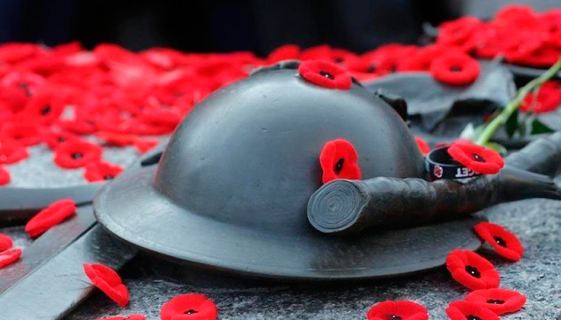
We remember the heroes
It should be noted that Ukraine, not only among several Soviet republics, but from all countries of the world, noted the greatest loss during the war. According to various estimates, between 8 million and 10 million people died in Ukraine, of which about 5 million were civilians, 2.2 million were deported to forced labor in national Germany, and 10 million lost asylum. More than 700 urban-type towns and villages, almost 30,000 villages, were turned into complete ruins
Today, the memory of everyone who fought against Nazism is honored, and the solidarity and fighting brotherhood of all the United Nations, both the state and the then stateless peoples, is emphasized. At the same time, the emphasis should be shifted from the history of hostilities to the history of specific people, and communication in favor of remembrance should be abandoned.

Slide 5
we remember, we love, we are proud
Thanks for your attention!!!

